Slide 1
Survey of Cloud Computing and Azure Foundation
Module 1, Lesson 2:
Cloud Computing Services

Slide 2
Topics
Software (as a service) Cloud Service
Platform (as a service) Cloud Service
Infrastructure (as a service) Cloud Service
Other Types of Cloud Services

Slide 3
Objectives
By the end of this lesson you should be able to:
Explain cloud service models and the underlying division of responsibility that distinguishes them
Understand current SaaS, PaaS, and IaaS services
Discuss other types of services and the overall direction towards XaaS (Everything as a Service)

Slide 4
Service Model Division of Responsibility
Infrastructure
(as a Service)
Platform
(as a Service)
Software
(as a Service)
On-Premises
Applications
Applications
User Managed
Applications
Applications
User Managed
Data
Data
Data
Data
Runtime
Runtime
Runtime
Runtime
Managed by Provider
User Managed
Middleware
Middleware
Middleware
Middleware
Managed by Provider
Operating System
Operating System
Operating System
Operating System
Managed by Provider
Virtualization
Virtualization
Virtualization
Virtualization
Servers
Servers
Servers
Servers
Storage
Storage
Storage
Storage
Networking
Networking
Networking
Networking
Notes:
Notes:
Review the division of responsibility between the cloud vendor and the user. We shall be using this distinction as we survey the various services available on cloud computing.

Slide 5
Software as a Service (SaaS)
Cloud service vendor is responsible for software, hardware, and infrastructure
Customers can reduce their upfront and ongoing maintenance costs and instead pay for services like a utility
Customers do not have as much freedom to customize the service and can only change parameter settings as provided by the cloud vendor
Applications
Data
Runtime
Managed by Provider
Middleware
Operating System
Virtualization
Servers
Storage
Networking
Notes:
Notes:
The vendor maintains and updates the software and upgrades the underlying hardware and infrastructure as necessary.
Customers are free from worrying about maintenance and simply use the service on a pay-as-you-go basis.

Slide 6
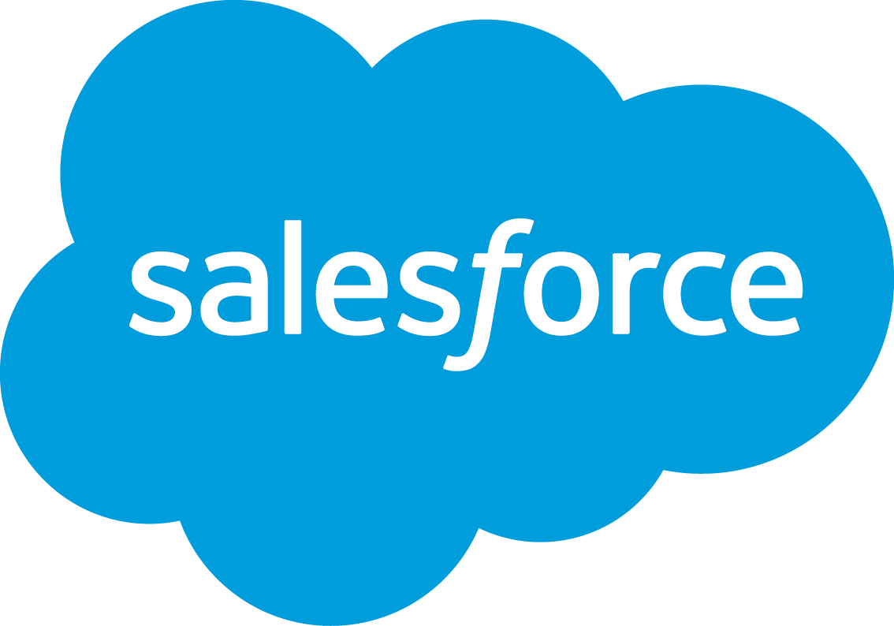
Salesforce.com as an SaaS
Online salesforce automation and CRM
The following are sales points advertised by Salesforce:
No vendor lock-in
No large up-front investment
No maintenance headaches
No steep learning curve
No outdated solutions
Notes:
Notes:
CRM – Customer Relations Management
References:
http://www.salesforce.com/
Image source: https://www.salesforce.com/content/dam/blogs/legacy/2014/12/6a00e54ee3905b883301b7c71e10cd970.jpg

Slide 7
Microsoft Office 365
Microsoft Office Suite on the Web
Flexible environment to collaborate and work together
Multiple environments
Desktop, tablet and mobile phones
Work anywhere, anytime, any device
Concurrent edits
Notes:
Notes:
Brings the Microsoft Office suite of applications to the Web.

Slide 8
GoToMeeting, WebEx, Skype
Most SaaSs have their roots on the desktop
Modern versions of old utilities
Think old TelCos
Services charged like utilities
Notes:
Notes:
Service only possible with widespread Internet
GoToMeeting, WebEx and Skype are examples of SaaS that only became possible with the widespread use and availability of the Internet.

Slide 9
Storage – SaaS or IaaS?
Backup storage services such as Google Drive, Box, and OneDrive should be considered SaaS; user is not responsible for the backup software
Storage services such as Azure Blobs and Amazon S3 are considered IaaS
Notes:
Notes:
Ask the students to think about where the responsibility lies in the above storage services.
In Google Drive, Box, and OneDrive, the users either install an application to seamlessly backup their data or else access their data from the Web.
They do not have to worry about the underlying hardware, software, or any of the infrastructure. Any update is performed by the vendor.
In Azure Blobs or Amazon S3, on the other hand, the user has much more control.
The user sets up the OS for their environment, either through a VM or through the provisioning of compute clusters
then adds storage devices to them with full control.

Slide 10
Platform as a Service (PaaS)
Cloud vendor responsible for everything necessary to deliver a platform
End-user responsible for maintaining the solutions and data created
End-user NOT responsible for maintaining and updating platform
PaaS end-users are often SaaS vendors
User Managed
Applications
Data
Runtime
Middleware
Managed by Provider
Operating System
Virtualization
Servers
Storage
Networking
Notes:
Notes:
The cloud vendor is responsible for everything necessary to deliver a platform on which developers can quickly develop software and applications, examine and analyze data, and test and deploy solutions.
The end-user is responsible for maintaining the actual solutions created as well their underlying data.

Slide 11
Salesforce.com as a PaaS (?)
Multi-tenant cloud
Multiple user have shared resources as well as dedicated resources
Metadata-driven architecture
All customizations (code, configuration, apps) are specified and saved as metadata
API-to-CRM engine
Trusted Multitenant
Cloud
Complete
CRM
Sales
Service
Marketing
Community
Analytics
Apps
Largest Enterprise Ecosystem
2,700+ Partner Apps
Flexible, Scalable, Metadata Platform
Fast App Dev and Customization
Data and Objects
Mobile UI
APIs
Workflow
Identity
Collaboration
Analytics
Notes:
Notes :
Continuing with the idea of PaaS end-users being SaaS vendors, we see that Salesforce.com has a PaaS aspect on which solution providers can use the underlying architecture, API, and other tools to develop solutions that can then be offered to the public as an SaaS.
The (?) on the title of the slide is to have students think about the service model, since Salesforce.com is most often thought of as an SaaS.
References:
https://developer.salesforce.com/trailhead/en/starting_force_com/starting_understanding_arch
https://www.salesforce.com/paas/overview/

Slide 12
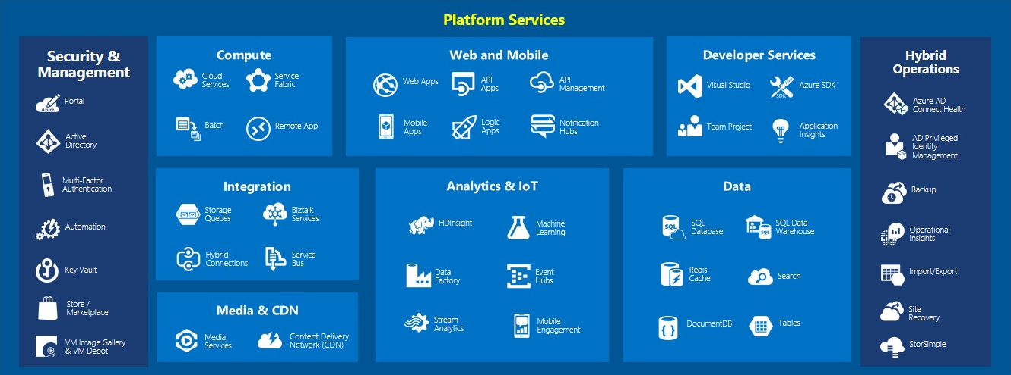
Azure Platform Services
Notes:
Notes:
Azure services will be reviewed in much more detail in the next lesson (Module1 Lesson 3).
Azure platform services are perhaps the best known and most comprehensive of the PaaS breed. Azure is quite extensive. Here we will highlight a few of its services.
Web and Mobile (also known as App services): Using these services, developers can quickly create and deploy mission critical Web apps that can be engaged with by employees, partners, and customers on any device at any time. Access and use of data can be managed as well (Logic Apps).
Compute: Provides highly available and scalable platform with more control than App Services (which are more for web and mobile apps).
Developer Services: Visual Studio and Team Project allow rapid development of enterprise software.
Integration: Provides cloud to on-premises and line-of-business application integration. This allows the user to connect to on-premises TCP, FTP, SFTP, REST, or HTTP resources.
Analytics and IoT (Internet of Things): Hadoop platforms are provided for big data development (HDInsight). A click-and-drag interface is available for building powerful predictive analytics. Allows real-time stream processing from millions of IoT devices.
Data: Storage is achieved using an elastic data warehouse and database as a service for SQL and NoSQL (DocumentDB).
Media and CDN: Allows service providers to encode, store, and stream video and audio files.
References:
Image Source: https://blogs.msdn.microsoft.com/niallsblog/2015/05/18/running-a-high-volume-website-on-azure-infrastructure-services/
Ima

Slide 13
Infrastructure as a Service (IaaS)
Cloud vendor responsible for underlying hardware and operating system
Provides user with the most flexibility
User can customize underlying hardware and operating system
Can be susceptible to vendor failure
AWS glitch in Sept. of 2015 brought down major services such as Netflix
Applications
User Managed
Data
Runtime
Middleware
Operating System
Managed by Provider
Virtualization
Servers
Storage
Networking
Notes:
Notes:
IaaS allows users to create a cluster of resources, including servers, storage, and networks to run highly customized development and deployment platforms.
Users should be cautious of completely depending on the IaaS vendor for fault tolerance.
They need to think about having their own fail safe system.
References:
http://www.infoworld.com/article/2985256/cloud-computing/aws-glitch-strikes-netflix-and-tinder-offering-a-wake-up-call-for-others.html

Slide 14
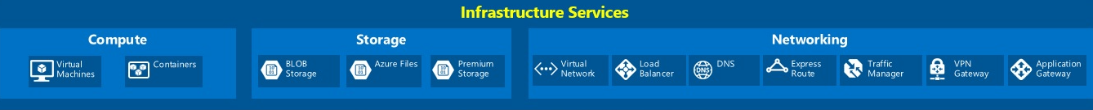
Azure Infrastructure Services
Notes:
Notes:
Compute: This is done using Windows and Linux Virtual Machines. Tools are provided to deploy and manage containers (a cluster of virtual machines that are preconfigured to run containerized applications).
Storage: Azure’s cloud storage solution is designed for modern applications that rely on durability, availability, and scalability to meet the needs of their customers.
Networking: Virtual networks are made available to create private networks or to connect to on-premises datacenters. A traffic manager and load balancer allow customers to route incoming traffic and deliver highly available network performance for applications. VPN services establish cross-premises connectivity.
References:
Image Source: https://blogs.msdn.microsoft.com/niallsblog/2015/05/18/running-a-high-volume-website-on-azure-infrastructure-services/

Slide 15
AWS EC2 and S3
Amazon Elastic Cloud Computing
Resizable and elastic compute capacity in the cloud
Abundant community images
Amazon Simple Storage Service
Online file storage web service
Accessible through REST, SOAP. and BitTorrent
Elastic load balancing
Automatic scaling
Elastic Block
Store
Elastic IP
Addresses
Management Console
Availability
Zones
Amazon EC2
Amazon EC2
Your Application
Multiple
Regions
Availability
Zones
Auto
Scaling
Elastic Load Balancing
Notes:
Notes:
Images available through Amazon EC2 include OS, and other development tools.
References:
https://aws.amazon.com/blogs/aws/new-aws-load-balancing-automatic-scaling-and-cloud-monitoring-services/

Slide 16
Desktop (as a service) Cloud Service
Provides and manages a virtual desktops
Allows smaller companies who find Virtual Desktop Infrastructure (VDI) to be cost prohibitive to deliver similar services
Quickly deploy new solutions across the entire enterprise located in multiple regions
Notes:
Notes:
Virtual desktop infrastructure (VDI) is the practice of hosting a desktop operating system within a virtual machine (VM) running on a centralized server.
VDI is a variation on the client/server computing model, sometimes referred to as server-based computing.

Slide 17
Monitoring (as a service) Cloud Service
Consists of tools and applications meant to monitor certain aspects of an application, server, system, or any other IT component
State monitoring is the most common service
The state of a component is constantly evaluated and results are displayed in real time
Applications
User Experience
Database
Network
Servers
Datacenter Infrastructure
Storage

Slide 18
Metal (as a service) Cloud Service
A bare metal provisioning system to rapidly deploy physical servers
Flexibility of cloud computing with power of actual physical servers
Serves as a layer underneath IaaS
Notes:
Notes:
Metal as a Service – MAAS – lets you treat physical servers like virtual machines in the cloud. Rather than having to manage each server individually, MAAS turns your bare metal into an elastic cloud-like resource
A bare metal provisioning system to rapidly deploy physical servers. Can scale up and down just like cloud computing.
Move away from Virtualization back to actual servers
Service to provide the flexibility and ease of cloud computing but with the speed and power of actual metal servers
Serves as a layer underneath IaaS
Juju (formerly Ensemble) is an open source service orchestration management tool developed by Canonical Ltd., the company behind Ubuntu. Juju allows software to be quickly deployed, integrated and scaled on a wide choice of cloud services or servers.
References:
https://maas.ubuntu.com/docs/ https://en.wikipedia.org/wiki/Juju_(software)

Slide 19
Communication (as a service) Cloud Service
Includes enterprise communication solutions such as VoIP (Voice over IP), instant messaging (IM), and video conferencing that can be leased
Vendor is responsible for all hardware and software and offers guaranteed Quality of Service
Audio
Conferencing
HD Voice
and
Video
Laptop and
Mobile Communicator
Chat
and
Presence
IP
Phones

Slide 20
Database (as a service) Cloud Service
Cloud-based approach to the storage and management of structured and unstructured data
Rather than offering raw storage platforms, this service offers functionality of database platforms such as SQL Server, MySQL, Oracle, and NoSQL
Cloud 2
Notes:
References:
whatis.techtarget.com/definition/Database-as-a-Service-DBaaS

Slide 21
Summary
In this lesson, you have learned:
Service Models
IaaS, PaaS, SaaS
Move towards XaaS (Everything as a Service)
Database
Desktop
Communications
Metal
Monitoring
Notes:
Notes:
While most cloud computing services fall under the traditional IaaS, PaaS, and SaaS models, we see that more and more other types of services are being offered. Most of these services can really be categorized as special cases of the traditional models, while services such as Metal-as-a -Service move away from virtualization and go one layer beneath the traditional IaaS.
What else: Data as a Service (provides information such as statistics on athletes), Network as a Service (provides network services), Marketing as a Service, Healthcare as a Service, etc. Maybe students can think of other services that can be delivered over the cloud.

